Slide 1
CSE101-Lec#5-First Part
Operators

Slide 2
In this lecture we will study
Operators
Types of Operators

Slide 3
Operators
Operator is the symbol which performs some operations on the operands.
5+5=10
+ and = are the operator and
5 and 10 are operands

Slide 4
Types of Operators
Types of operators are:
Arithmetic operator
Unary operator
Relational operator
Logical operator
Assignment operator
Conditional operator
Bitwise operator
Special operator

Slide 5
Description of Operators
Arithmetic Operators
These are binary operators i.e. expression requires two operands
Operator | Description | Example (a=4 and b=2)
+ | Addition of two operands | a + b = 6
- | Subtraction of two operands | a – b = 2
* | Multiplication of two operands | a * b = 8
/ | Division of two operands | a / b = 2
% | Modulus gives the remainder after division of two operands | a % b = 0

Slide 6
Arithmetic Operators
If the radius of car wheel is 15inch then what will the diameter and calculate distance traveled after one rotation of that wheel?
Sol:
r = 15
diameter = r + r = 2 * r = 2 * 15 = 30
dist_travelled = pi * d
dist_travelled = pi * diameter
= 3.14 * 30 = 94.2
Arithmetic Operators

Slide 7
Arithmetic Operators
To get the remainder of the integer value.
Eg:
14 mod 3 = 2
17 mod 2 = 1
190 mod 3 = 1
Q:Suppose we have to distribute 10 chocolates among 3 students equally then after equal distribution how many chocolates will be left?
Sol: 10 mod 3 = 1
So 1 chocolate will be left as all 3 students will have 3 chocolates each.
3)14(4
12
2

Slide 8
Q1
What will be the output of the following C code?
#include <stdio.h>
int main()
{
int i = -3;
int k = i % 2;
printf("%d\n", k);
return 0;
}
A. Compile time error
B. -1
C. 1
D. None of these
Notes:
B

Slide 9
Q2
What will be the output of the following C code?
#include <stdio.h>
int main()
{
int i = 3;
int l = i / -2;
int k = i % -2;
printf("%d %d\n", l, k);
return 0;
}
A. Compile time error
B. -1 1
C. 1 -1
D. None of these
Notes:
b

Slide 10
Q3
What will be the final value of x in the following C code?
#include <stdio.h>
int main()
{
int x = 5 * 9 / 3 + 9;
printf("%d",x);
return 0;
}
A. 3.75
B. Depends on compiler
C. 24
D. 3
Notes:
c

Slide 11
Q4
What will be the output of the following C code?
#include <stdio.h>
int main()
{
int x = 5.3 % 2;
printf("Value of x is %d", x);
return 0;
}
A. Value of x is 2.3
B. Value of x is 1
C. Value of x is 0.3
D. Compile time error
Notes:
d

Slide 12
Q5
What will be the output of the following C code?
#include <stdio.h>
int main()
{
int a = 10;
double b = 5.6;
int c;
c = a + b;
printf("%d", c);
return 0;
}
A. 15
B. 16
C. 15.6
D. 10
Notes:
A

Slide 13
Unary Operator
These operator requires only one operand.
Operator | Description | Example(count=1) [all operation are independent]
+ | unary plus is used to show positive value | +count; value is 1
- | unary minus negates the value of operand | -count; value is -1
++ | Increment operator is used to increase the operand value by 1 | ++count; value is 2 count++; value is 2
-- | Decrement operator is used to decrease the operand value by 1 | --count; value is 0 count--; value is 0
++count increments count by 1 and then uses its value as the value of the expression. This is known a prefix operator.
count++ uses count as the value of the expression and then increments count by 1. This is known as postfix operator.

Slide 14
Difference between Prefix and Postfix
Unary Prefix increment/ decrement performs the operation first, and then the value is assigned/ or used
Example:
Consider x=2, then
y = ++x; is equivalent to writing
//x = x + 1;
//y = x;
So eventually x will be incremented by 1, i.e x will become 3, and then the value 3 will be assigned to y
Unary Postfix increment/ decrement will assign/ or use the value first and then the operation is performed
Example:
Consider x=2, then
y = x++; is equivalent to writing
//y = x;
//x=x+1;
Here y will take value 2, and then the value of x will be increment by 1, and x becomes 3.

Slide 15
Difference between Prefix and Postfix
Explanation:
Initialize x to 3
Assign y the value we get by evaluating the expression x++, i.e, the value of x before increment then increment x.
Increment x then assign z the value we get by evaluating the expression ++x, i.e, value of x after the increment.
Print these values
Example:
#include<stdio.h>
int main() {
int x = 3, y, z;
y = x++;
z = ++x;
printf(“\n%d,%d,%d”,x,y,z);
return 0;
}
Output:
5, 3, 5

Slide 16
Q1
What will be the output of following code?
#include <stdio.h>
int main()
{
int a=1,b=1,c;
c = a++ + b;
printf("%d,%d,%d", a,b,c);
return 0;
}
A. 2,1,1
B. 1,2,1
C. 2,1,2
D. 1,1,2

Slide 17
Q2
What will be the output of following code?
#include <stdio.h>
int main()
{
int d, a = 1, b = 2;
d = a++ + ++b;
printf("%d %d %d", d, a, b);
return 0;
}
A. 4 2 2
B. 3 1 2
C. 4 2 3
D. 3 2 3

Slide 18
Q3
What will be the output of following code?
#include <stdio.h>
int main()
{
int i = 0;
int x = i++;
int y = ++i;
printf("%d % d\n", x, y);
return 0;
}
A. 0, 2
B. 0, 1
C. 1, 2
D. 1, 1

Slide 19
Q4
What will be the output of the following C code?
#include <stdio.h>
int main()
{
int x = 4, y, z;
y = --x;
z = x--;
printf("%d%d%d", x, y, z);
return 0;
}
A. 3 2 3
B. 2 3 3
C. 3 2 2
D. 2 3 4

Slide 20
Relational Operator
It compares two operands depending upon the their relation. Expression generates zero(false) or nonzero(true) value.
Operator | Description | Example (a=10 and b=20)
< | less than, checks if the value of left operand is less than the value of right operand, if yes then condition becomes true. | (a < b) value is 1(true)
<= | less than or equal to, checks if the value of left operand is less than or equal to the value of right operand, if yes then condition becomes true. | (a <= b) value is 1 (true).
> | greater than, checks if the value of left operand is greater than the value of right operand, if yes then condition becomes true. | (a > b) value is 0 (false).
>= | greater than or equal to, checks if the value of left operand is greater than or equal to the value of right operand, if yes then condition becomes true. | (a >= b) value is 0 (false).
== | equality ,checks if the value of two operands is equal or not, if yes then condition becomes true. | (a == b) value is 0 (false).
!= | inequality, checks if the value of two operands is equal or not, if values are not equal then condition becomes true. | (a != b) value is 1 (true).

Slide 21
Relational Operator
Q: Age of Sam is 20 and age of Tom is 19.
Verify the relationship between their age.
Sol: age of Sam = S1 = 20
age of Tom = T1 = 19
S1 < T1 = 0 (false)
S1 > T1 = 1 (true)
So, Sam is elder than Tom.
S1 == T1 = 0 (false)

Slide 22
Q1
What will be the output of following code?
#include <stdio.h>
int main()
{
int a=1,b=2,c;
c=a>b;
printf("\n%d",c);
return 0;
}
A. 0
B. 1
C. 2
D. None of these

Slide 23
Q2
What will be the output of following code?
#include <stdio.h>
int main()
{
int a=1,b=2;
printf("\n%d",a!=b);
return 0;
}
A. 0
B. 1
C. 2
D. None of these

Slide 24
Q3
What will be the final value of d in the following C code?
#include <stdio.h>
int main()
{
int a = 10, b = 5, c = 5;
int d;
d = b + c == a;
printf("%d", d);
return 0;
}
A. Syntax error
B. 1
C. 5
D. 10

Slide 25
Logical Operator
It checks the logical relationship between two expressions and the result is zero( false) or nonzero(true).
Operator | Description | Example
&& | Logical AND operator. If both the operands are true then condition becomes true. | (5>3 && 5<10) value is 1 (true).
| | | Logical OR Operator. If any of the two operands is true then condition becomes true. | (5>3 || 5<2) value is 1 (true).
! | Logical NOT Operator. Use to reverses the logical state of its operand. If a condition is true then Logical NOT operator will make false. | !(8==8) value is 0 (false).

Slide 26
Logical Operator
Grade system :
If (Marks >=90 || marks == 100)
students performance is excellent.
If (Marks <= 40 && attendance < 75)
student is detained.

Slide 27
Q1
//What will be the output of following code?
#include <stdio.h>
int main()
{
int a = 10, b = 0,c;
c=a&&b;
printf("%d",c);
}
A. 0
B. 1
C. -1
D. None of these

Slide 28
Q2
What will be the output of following code?
#include <stdio.h>
int main()
{
int a = 10, b = 0,c=2,d;
d=a&&b||c-2;
printf("%d",d);
}
A. 0
B. 1
C. -1
D. None of these

Slide 29
Q3
What will be the output of the following C code?
#include <stdio.h>
int main()
{
int x = 1, y = 0, z = 5;
int a = x && y || z++;
printf("%d", z);
return 0;
}
A. 6
B. 5
C. 0
D. None of these

Slide 30
Q4
What will be the output of following code?
#include <stdio.h>
int main()
{
int x = 1, y = 0, z = 5;
int a = x && y && z++;
printf("%d", z);
return 0;
}
A. 6
B. 5
C. 0
D. None of these

Slide 31
Assignment Operator
They are used to assign the result of an expression on right side to a variable on left side.
Operator | Description | Example(a=4 and b=2)
+= | a=a+b | a+=b; a=a+b = 6
-= | a=a-b | a-=b; a=a-b = 2
*= | a=a*b | a*=b; a=a*b = 8
/= | a=a/b | a/=b; a=a/b = 2
%= | a=a%b | a%=b; a=a%b = 0
<<= | a=a<<b | a=00000100 << 2 = 00010000
>>= | a=a>>b | a=00000100 >> 2 = 00000001
&= | a=a&b | (a=0100, b=0010) a&=b; a=a&b = 0000
|= | a=a|b | (a=0100, b=0010) a|=b; a=a|b =0110
^= | a=a^b | (a=0100, b=0010) a^=b; a=a^b = 0110

Slide 32
Assignment Operator
To increase the cost of item soap by 50rs.
Cost_soap = Cost_soap + 50;
or Cost_soap += 50;
To double the quantity of water in a bowl.
Water_inBowl *= 2;
Therefore assignment operator are used to store the changed value of the variable in the same variable.

Slide 33
Conditional Operator
Conditional operator contains condition followed by two statements. If the condition is true the first statement is executed otherwise the second statement.
It is also called as ternary operator because it requires three operands.
Operator | Description | Example
?: | conditional expression, Condition? Expression1: Expression2 | (a>b)? “a is greater”: “b is greater”

Slide 34
Conditional Operator
Eligibility to cast vote
(age>=18)? “can cast vote”: “cannot cast vote”;
In C
(age>=18)? printf(“can cast vote”) : printf(“cannot cast vote”);

Slide 35
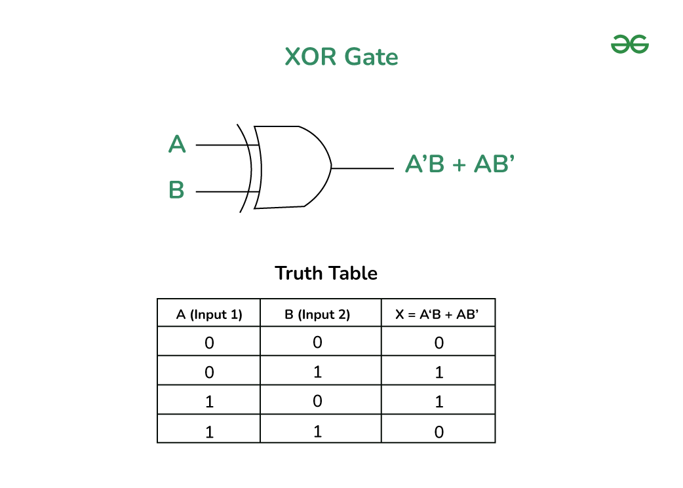
Bitwise Operator
A bitwise operator works on each bit of data.
Logical Table
a | b | a & b | a | b | a ^ b
0 | 0 | 0 | 0 | 0
0 | 1 | 0 | 1 | 1
1 | 1 | 1 | 1 | 0
1 | 0 | 0 | 1 | 1
Operator | Description | Example(a=1 and b=0)
& | bitwise AND | a & b = 0
| | bitwise OR | a| b = 1
^ | bitwise XOR | a ^ b = 1
~ | bitwise one’s complement | ~a = 0, ~b=1
<< | bitwise left shift, indicates the bits are to be shifted to the left. | 1101 << 1 = 1010
>> | bitwise right shift, indicates the bits are to be shifted to the right. | 1101 >> 1 = 0110

Slide 36
Explanation
The & (bitwise AND) in C takes two numbers as operands and does AND on every bit of two numbers. The result of AND is 1 only if both bits are 1.
The | (bitwise OR) in C takes two numbers as operands and does OR on every bit of two numbers. The result of OR is 1 if any of the two bits is 1.
The ^ (bitwise XOR) in C takes two numbers as operands and does XOR on every bit of two numbers. The result of XOR is 1 if the two bits are different.
The << (left shift) in C takes two numbers, left shifts the bits of the first operand, the second operand decides the number of places to shift.
The >> (right shift) in C takes two numbers, right shifts the bits of the first operand, the second operand decides the number of places to shift.
The ~ (bitwise NOT) in C takes one number and inverts all bits of it

Slide 37
Program Example
#include <stdio.h>
int main()
{
int a = 2, b = 4;
printf("a = %d, b = %d\n", a, b);
printf("a&b = %d\n", a & b);
printf("a|b = %d\n", a | b);
printf("a^b = %d\n", a ^ b);
printf("~a = %d\n", a = ~a);
printf("b<<1 = %d\n", b << 1);
printf("b>>1 = %d\n", b >> 1);
return 0;
}
Output:
a = 2, b = 4
a&b = 0
a|b = 6
a^b = 6
~a = -3
b<<1 = 8
b>>1 = 2

Slide 38
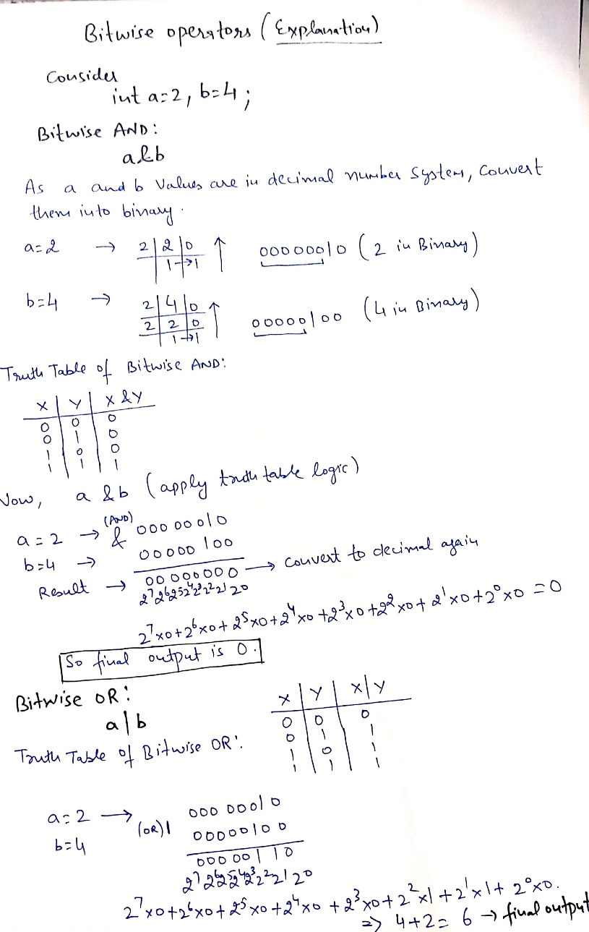
Explanation

Slide 39
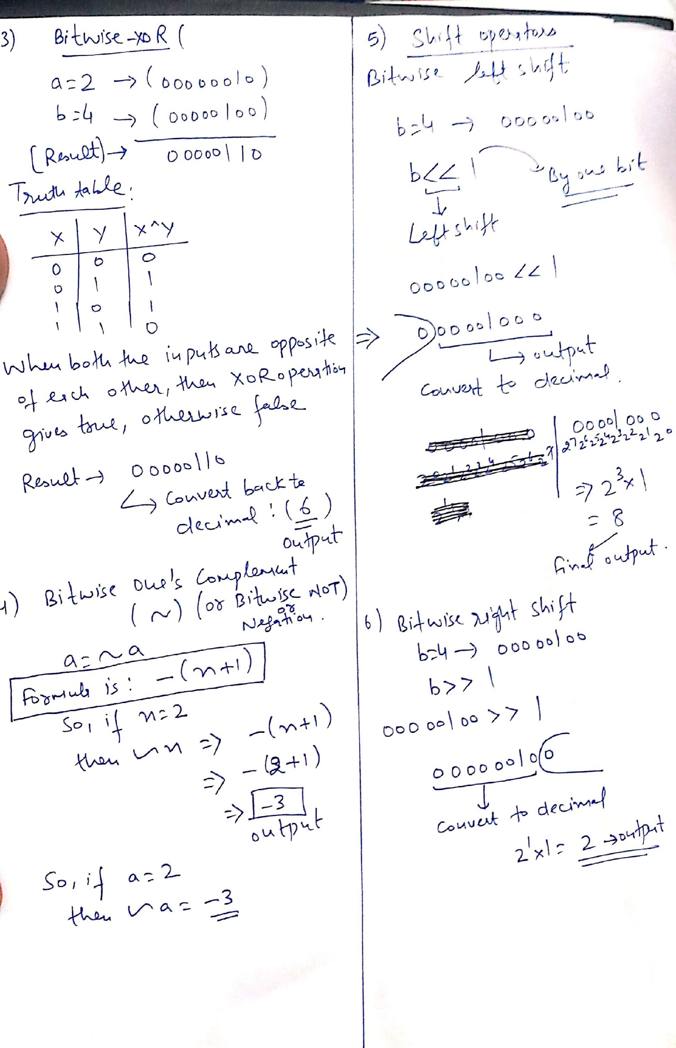

Slide 40
Q1
What will be the output of following code?
#include<stdio.h>
int main()
{
int a=10,b=5;
printf("%d",a&b);
return 0;
}
10
5
0
1

Slide 41
Q2
What will be the output of following code?
#include<stdio.h>
int main()
{
int a=7,b=5;
printf("%d",a|b);
return 0;
}
7
5
12
0

Slide 42
Q3
What will be the output of following code?
#include<stdio.h>
int main()
{
int a=8,b=3;
printf("%d",a^b);
return 0;
}
8
3
1
11

Slide 43
Q4
What will be the output of following code?
#include<stdio.h>
int main()
{
int a=10;
printf("%d",~a);
return 0;
}
11
-11
9
-9

Slide 44
Some Special Operators
Operator | Description | Example
, | comma operator, can be used to link the related expressions together | int a, b, x;
sizeof () | sizeof operator to find the size of an object. | int a; sizeof(a)=2
type | Cast operator, to change the data type of the variable | float x= 12.5; int a; a = (int) x; value of a is 12.

Slide 45
Explanation
COMMA OPERATOR
The comma operator in C takes two operands. It works by evaluating the first and discarding its value, and then evaluates the second and returns the value as the result of the expression.
Comma separated operands when chained together are evaluated in left-to-right sequence with the right-most value yielding the result of the expression.
Among all the operators, the comma operator has the lowest precedence. For example,
int a=2, b=3, x=0;
x = (++a, b+=a);
Now, the value of x = 6.
sizeof operator
sizeof is a unary operator used to calculate the sizes of data types.
It can be applied to all data types.
The operator returns the size of the variable, data type or expression in bytes.
'sizeof' operator is used to determine the amount of memory space that the variable/expression/data type will take. For example,
sizeof(char) returns 1, that is the size of a character data type

Slide 46
Comma operator can be used like:
for(i=0 , j=1 ; i>10 ; i++ , j++)
To know space occupied by variable in computer memory we use sizeof() operator.
char choice;
int char_sz = sizeof(choice); // 1 because char is 1byte
If we are adding float number and integer number and we require output in float then integer number is converted to float using type cast operator.
int num1;
float num2, sum;
sum= (float) num1 + num2;

